Slide 1
Analysis and the Application of Classification Models In Detecting Online Hate Speech

Slide 2
Members
Ami, Julius Lorenz
Capulong, Mark
Cueva, Larry Miguel
Osorio, Bryan
Ore, Gabriel
Panlilio, Andrei Shane
Zabala, Leonard Howell

Slide 3

Introduction
Freedom of speech or expression is very important for a country to give everyone the right to express their thoughts and opinions about a certain idea or topic. But not every thought or opinion they express is a sensible one. This is where hate speech comes along, it is hate speech when it is directly attacking a person or group of people in an offensive manner.

Slide 4
Literature Review
Title | Description
How well do hate speech, toxicity, abusive and offensive language classification models generalize across datasets? Fortuna, P., Soler-Company, J., & Wanner, L. (2021) | The paper discussed the cross-dataset generalization and discussed the possible impact of dataset characteristics and model in generalization.
A Survey on Hate Speech Detection using Natural Language Processing. Schmidt, A. and Wiegand, M. (2017) | Discussed the detection of hate speech in the growing body of social media content in the entire world, to determine the rise of hate speech in the platform.
Towards generalisable hate speech detection: A review on obstacles and solutions. Zubiaga, A., et. al (2021) | Hate speech detection can be challenging due to the limitations of existing NLP techniques, dataset construction, and the characteristics of online hate speech, which are frequently mixed up.
Text Classification Using Support Vector Machine with Mixture of Kernel. Wei, L, Wei, B. and Wang, B. (2012) | Most of the classifiers are based on the methods from information retrieval and the machine learning algorithms that are introduced for text classification purposes.

Slide 5
Literature Review
Title | Description
Analytics of machine learning-based algorithms for text classification. Hassan, S.U., Ahamed, J., Ahmad, K. (2022) | Logistic Regression is quick to train data, works well for categorical data, for Simple parameter Estimation and better for linear data. It is not better for non-linear data and requires a large sample size.
A Survey on Text Classification: From Traditional to Deep Learning. Li, Q., Peng, H., Li, J., Xia, C., Yang, R., Sun, L., Yu, P.S. and He, L.. (2021) | The multilayer perceptron from the study of Alsmadi, et al. (2009) and the recursive neural network from Pouyanfar, et al. (2018) are the first two deep learning approaches used for the text classification task, which improves performance compared with traditional models. CNNs, Recurrent Neural Networks (RNNs), and attention mechanisms are used for text classification. (Qin, L., et al. 2020, Deng, Z., et al. 2021 and Zhao, et al. 2018)

Slide 6
Problem
Opinions
Internet and Social Media limits
Abuse of freedom of Expression
Combat Hate Speech

Slide 7

Dataset description
Combined, handpicked, and curated these datasets to form a much larger corpus of words and sentences from Mollas, I., Chrysopoulou, Z., Karlos, S. et al. (2022), Kurrek, J., Saleem, H. M.; Ruths, D. (2019), and T-Davidson. (2020).
ETHOS Hate Speech Dataset (2022)
Automated Hate Speech Detection and the Problem of Offensive Language (2019)
Towards a Comprehensive Taxonomy and Large-Scale Annotated Corpus for Online Slur Usage (2020)

Slide 8
Dataset description
The combined corpus contained a total of 65780 records of comments drawn from the three sources together with its labels
3 - Homonym which had 1998 records
2 - derogatory which had 22395 records
1 - non-derogatory which had 21644 records
0 - offensive which had 19743 records
Derogatory by definition is showing a critical and disrespectful attitude to someone. Non-derogatory by definition is the opposite of derogatory. Offensive by definition are the comments that can cause someone to feel upset and angry, mainly because they are rude. Homonymous, on the other hand is defined as a word spelled or pronounced the same but have different meaning.

Slide 9
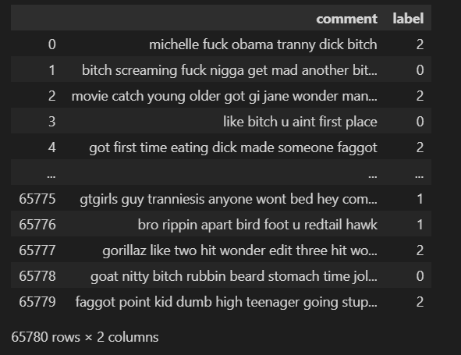
Dataset description
After pre-processing

Slide 10
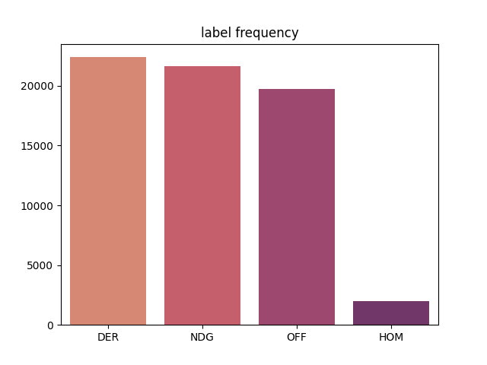

Slide 11
Purpose
The main purpose of this experiment is to classify hate speeches using Long Short-Term Memory (LSTM) and Softmax Regression. The experiment is inspired by the study of Muslim, A., et al. (2020), where they used it for the Twitter dataset.
According to the research of Almeida F. (2019), word embeddings are highly useful in NLP tasks such as parsing and sentiment analysis, chunking, and question and answer. These advancements are now included in several toolkits, such as Word2Vec, Gensim, and GloVe, allowing for more accurate and less time-consuming usage for word embeddings. With those findings, this experiment will also utilize word embeddings, and the results from LSTM and Softmax Regression will be compared to see which methods will provide better results and be able to classify hate speeches correctly.

Slide 12
Purpose
Once engineering the dataset was finished, we wanted to answer the following questions
1. What words were most frequently attributed in derogatory comments?
2. What were the percentages of the frequent derogatory comments?
3. What words were most frequently attributed in offensive comments?
4. What were the percentages of the frequent offensive comments?
5. What words were most frequently attributed in non-derogatory comments?
6. What were the percentages of the frequent non-derogatory comments?
7. How best would we be able to automate the detection or even regulate these inflammatory comments?

Slide 13
Proposed Solution
we propose a two classifiers of these comments. The other using a deep learning approach particularly an LSTM Neural Network model and the other a simple generalized version of logistic regression called the Softmax Regression model suited best for multi class classification
Machine learning models work on numbers the next problem was how would we feed words to a model such that it was able to detect sentences or phrases that were known to either be derogatory, non-derogatory, offensive, or homonymous

Slide 14
Proposed Solution
According to Ameida, F. & Xexeo, G. (2019) words have been found to be useful by representing them as vectors which lend themselves well to be used in many Machine Learning (ML) algorithms and strategies.
Also stated that words with similar contexts (other words) have the same meaning.

Slide 15
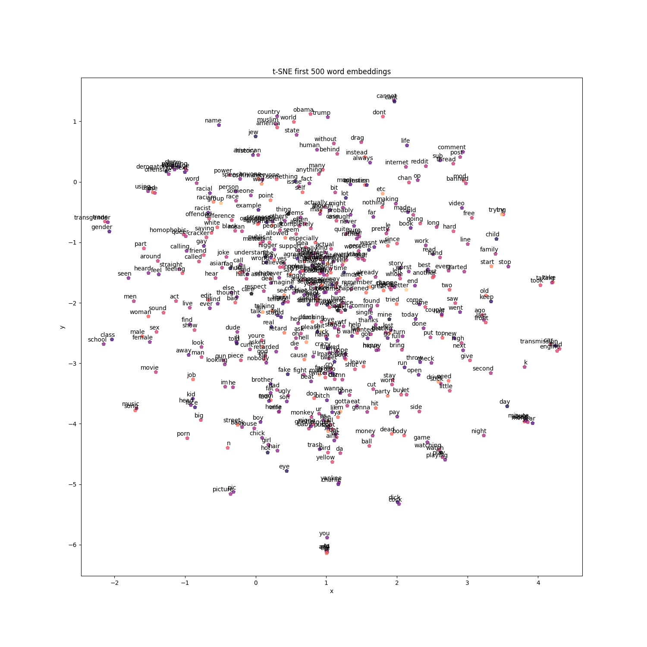

Slide 16
Proposed Solution
We can represent these embeddings in a lower dimensional such that words can be visualized in a 2D plane or 3D plane. T-distributed Stochastic Neighbor Embedding (T-SNE) is a machine learning algorithm for data visualization, which is based on a nonlinear dimensionality reduction technique.
More recently ways of creating embeddings have surfaced, Among the most influential models is that of the GloVe model by Pennington, J., et al. (2014).
Another model proposed was named ELMo (Embedding from language models) looks at the entire sentence as it assigns each word an embedding. Since it uses a bidirectional architecture, the embedding is based on both the next and previous words in the sentence. M.E. Peters, M. Neumann, M. Iyyer, M. Gardner, C. Clark, K. Lee, L. Zettlemoyer, Deep contextualized word representations, in: Proc. of NAACL, 2018
Many of the suggested advances seen in the literature have been incorporated in widely used toolkits, such as Word2Vec, gensim, FastText, and GloVe, resulting in ever more accurate and faster word embeddings to be used in NLP, as stated by Ameida, F. & Xexeo, G. (2019)

Slide 17
Proposed Solution
While various models have been proposed to train embeddings of numerous words such as Word2Vec, GloVe, ELMo etc., sometimes sparsity in data can occur.
Open source and publicly pre-trained embeddings can be of great use
we propose to use in this problem we can represent the words in our corpus in a vector space such that it is useful later, in the two models we have chosen to classify and detect certain phrases with derogatory, non-derogatory, offensive, or homonymous words.
Common crawl pre-trained word vectors also by Pennington, J., et al. (2014)

Slide 18
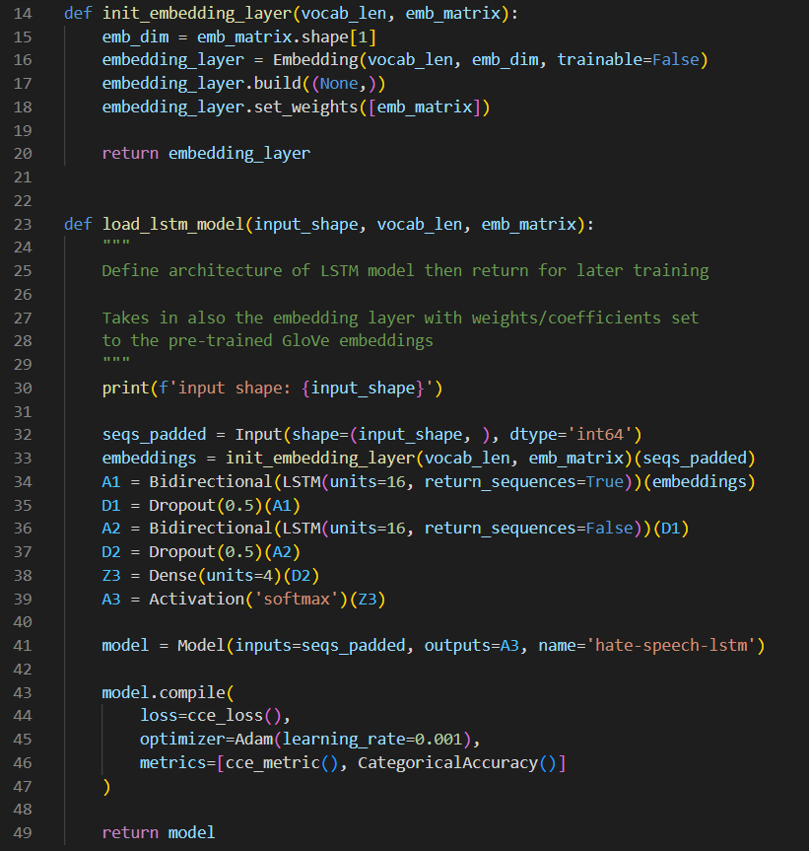
Lstm architecture and hyper parameters

Slide 19
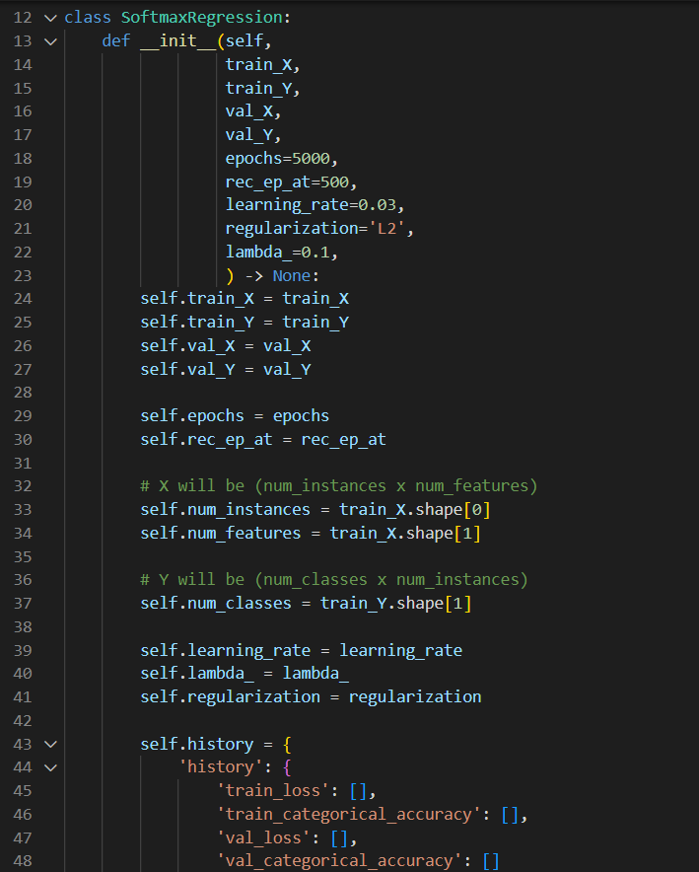
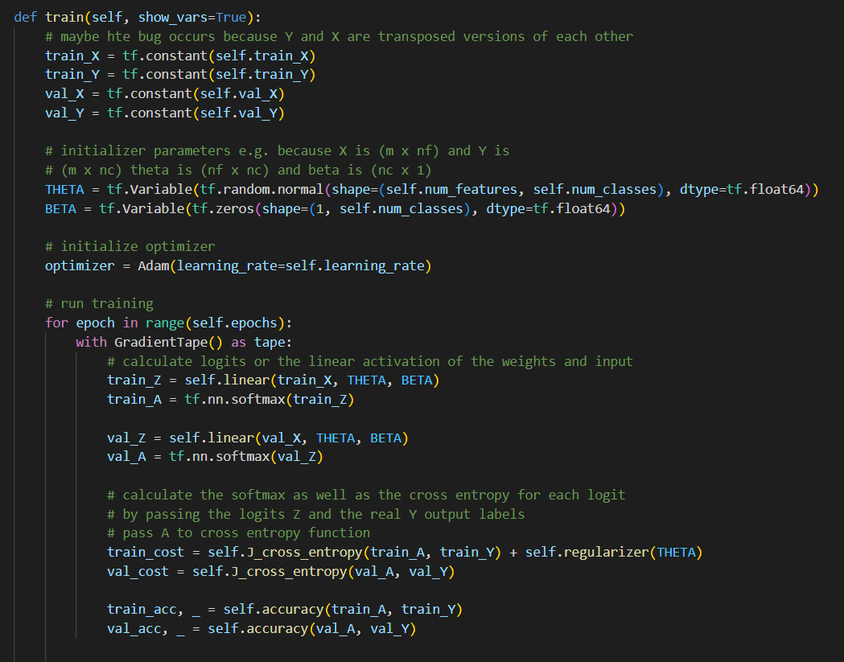
softmax architecture and hyper parameters

Slide 20
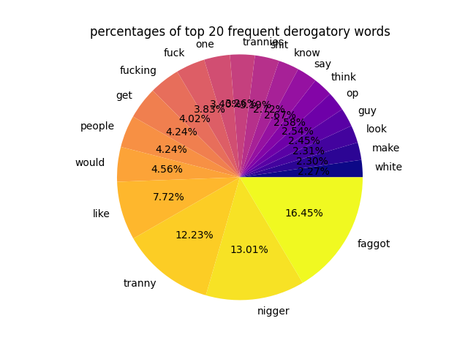
Percentage of top 20 Derogatory word frequencies

Slide 21
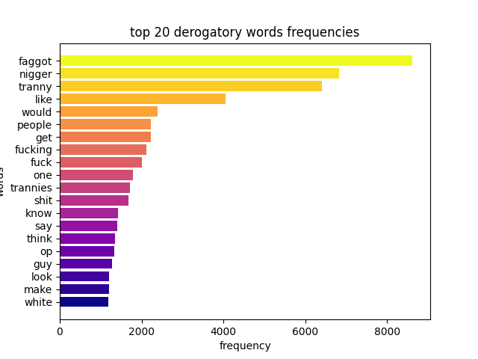
Top 20 Derogatory word frequencies

Slide 22
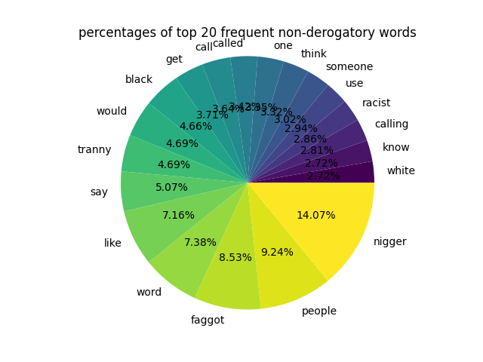
Percentage of Top 20 non -Derogatory word frequencies

Slide 23
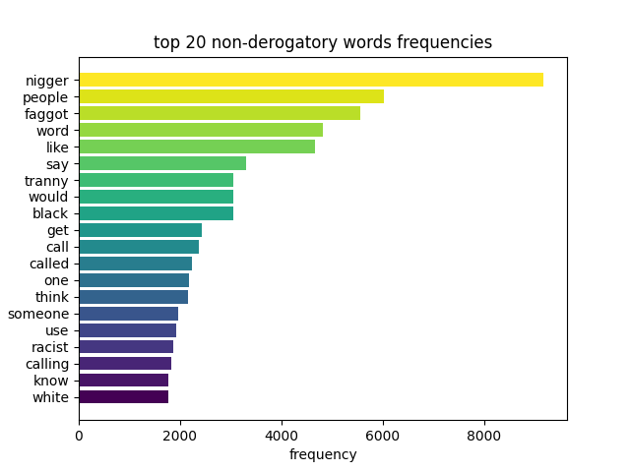
Top 20 Non-Derogatory word frequencies

Slide 24
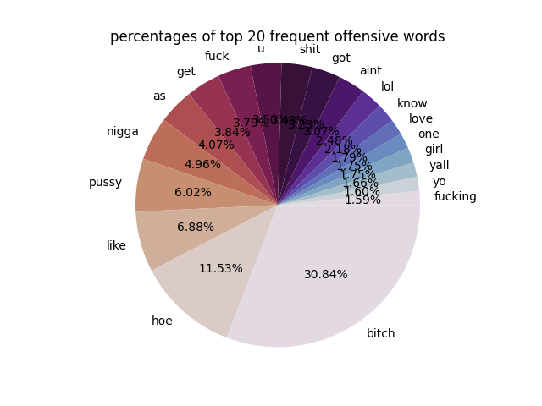
Percentage of top 20 offensive word frequencies

Slide 25
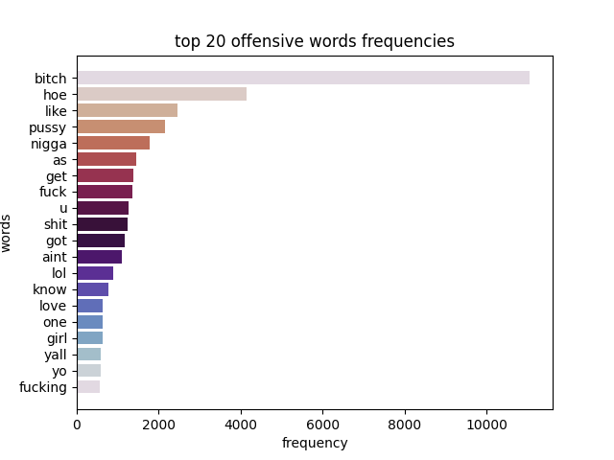
Top 20 offensive word frequencies

Slide 26
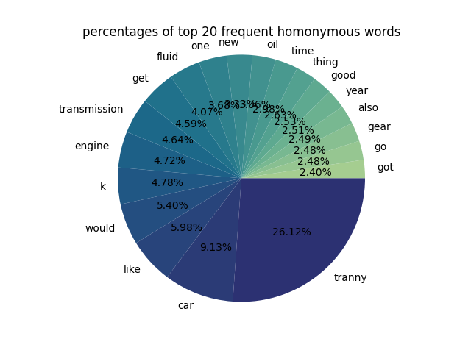
Percentage of top 20 homonymous word frequencies

Slide 27
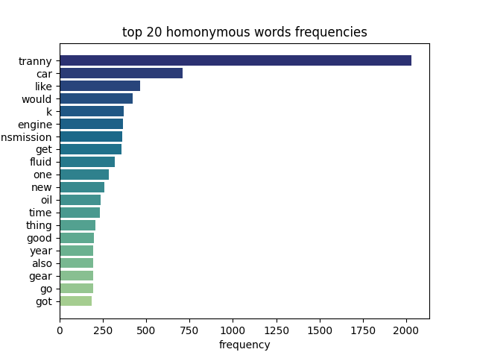
Top 20 homonymous word frequencies

Slide 28
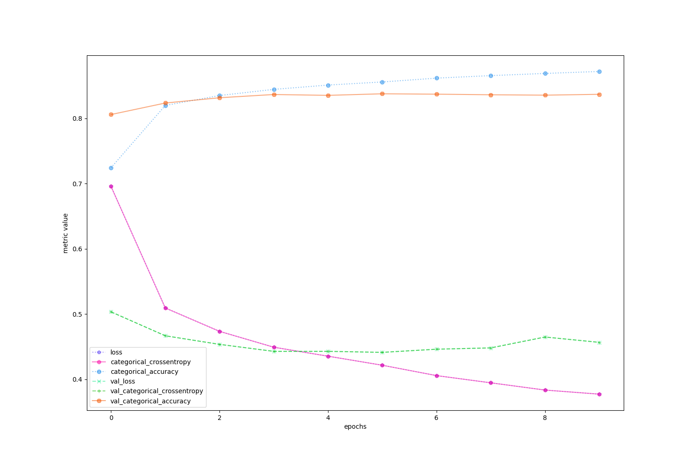
lstm neural network results

Slide 29
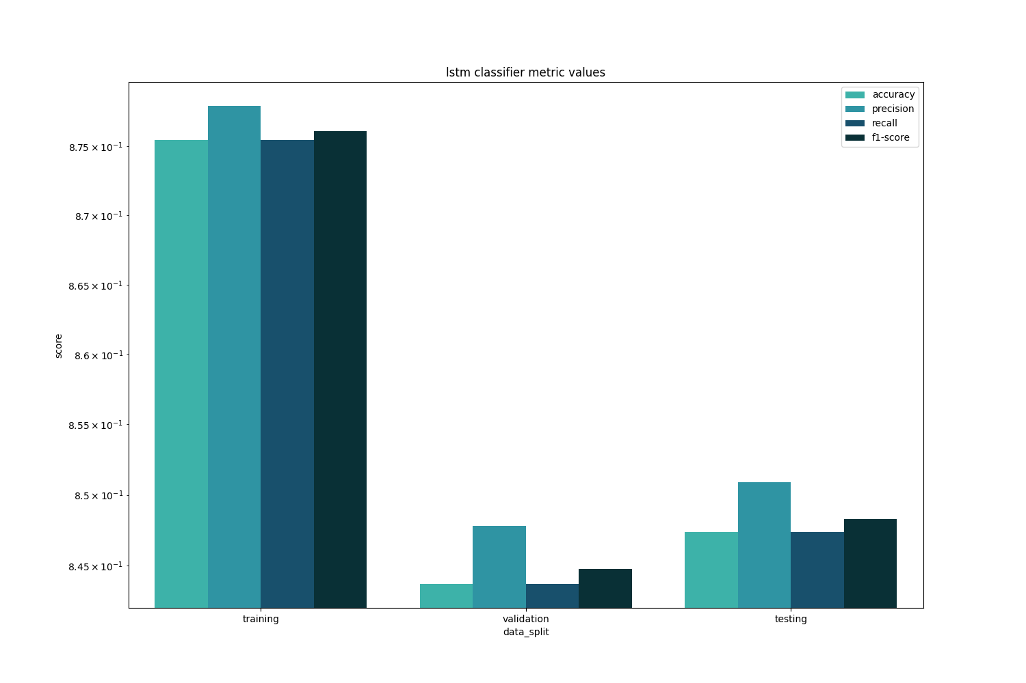
lstm classifier metric values

Slide 30
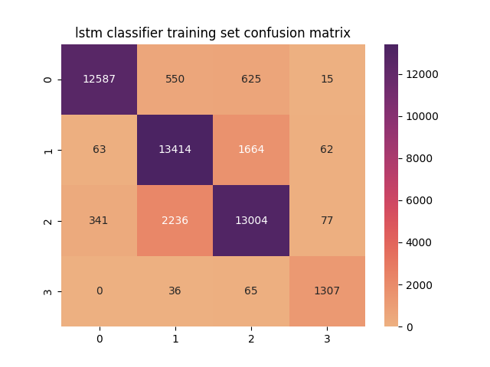


LTSM Classifier Confusion Matrices
Training
Validation
Testing
40,312
5,734
8,325
1,542
8,361
1,506

Slide 31
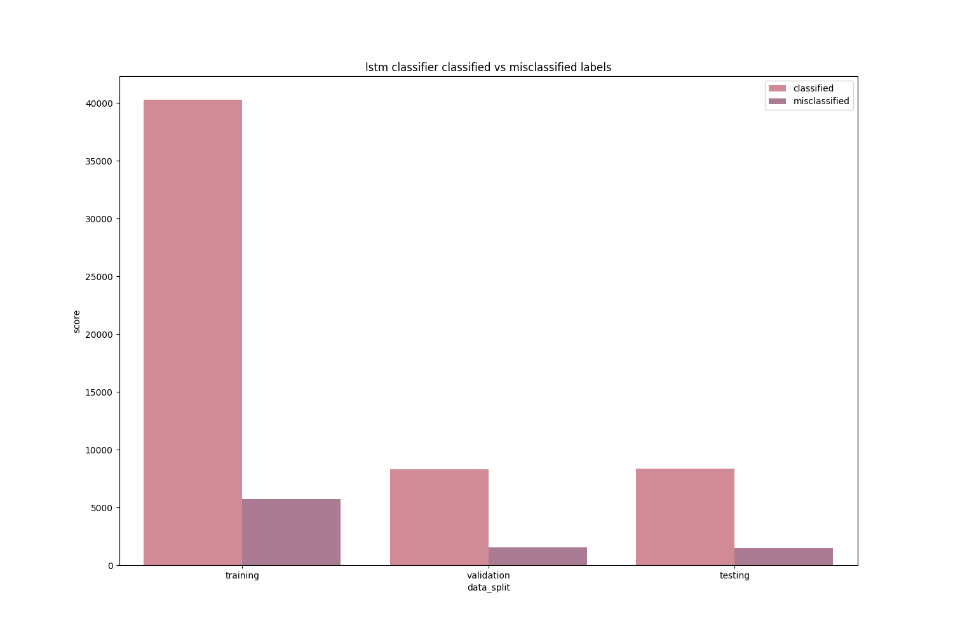
Lstm classifier classified vs misclassified labels
Training
40,312
5,734
Validation
8,325
1,542
Testing
8,361
1,506

Slide 32
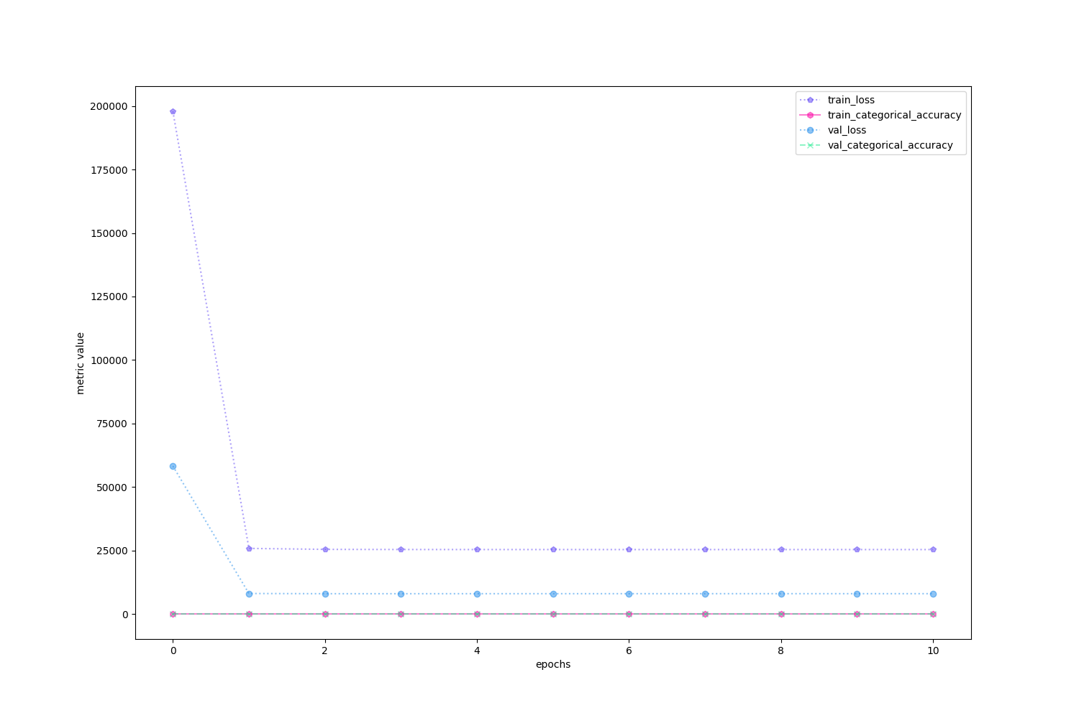
SOFTMAX REGRESSION results

Slide 33
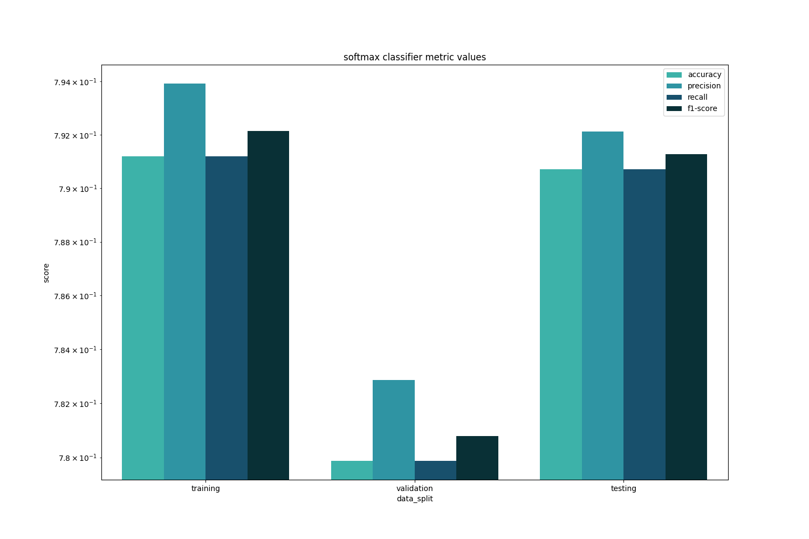
SOFTMAX REGRESSION results

Slide 34
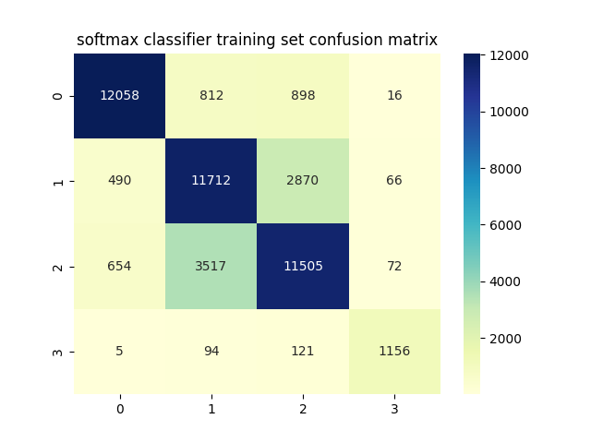
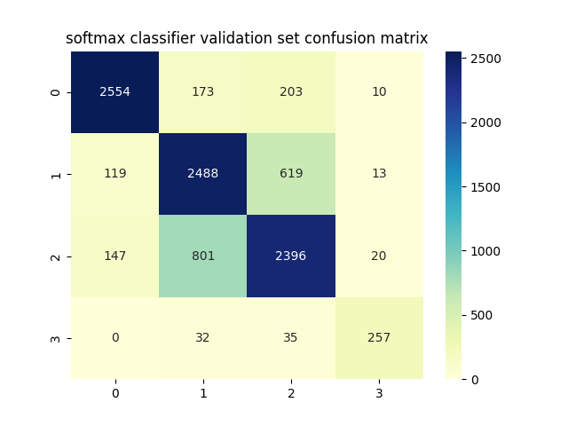

Softmax Classifier Confusion Matrices
Training
Validation
Testing
36,431
9,615
7,695
2,172
7,802
2,065

Slide 35
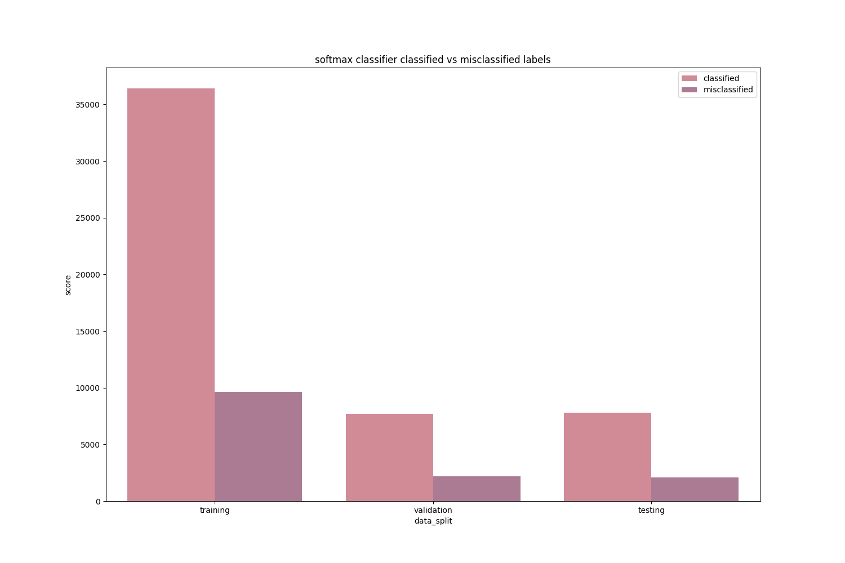
Softmax classifier classified vs misclassified labels
Training
36,431
9,615
Validation
7,695
2,172
Testing
7,802
2,065

Slide 36
Summary of findings
The created program has been able to identify into four categories: derogatory, non-derogatory, offensive, and homonymous words. The program was also able to determine the number of words and the percentage of each word.
Derogatory
faggot | 16.45%
nigger | 13.01%
tranny | 12.23%
fucking | 4.02%
fuck | 3.83%
Offensive
bitch | 30.84%
hoe | 11.53%
pussy | 6.02%
nigga | 4.96%
fuck | 3.79%
Homonymous
tranny | 26.12%
car | 9.13%
like | 5.98%
would | 5.40%
k | 4.78%
Non-Derogatory
nigger | 14.07%
people | 9.24%
faggot | 8.53%
word | 7.38%
like | 7.16%

Slide 37
Summary of findings
 | Training | Validation | Testing
Accuracy | 87.55% | 84.37% | 84.74%
Precision | 87.80% | 84.78% | 85.09%
Recall | 87.55% | 84.37% | 84.74%
F1 Score | 87.61% | 84.48% | 84.83%
LSTM Classifier Performance metrics
 | Training | Validation | Testing
Accuracy | 79.12% | 77.99% | 79.07%
Precision | 79.39% | 78.29% | 79.21%
Recall | 79.12% | 77.99% | 79.07%
F1 Score | 79.21% | 78.08% | 79.13%
Softmax Classifier Performance metrics

Slide 38
Summary of findings
The LSTM Classifier performed better in classifying hate speeches with an f-score of 87.61% for the training set, 84.48% for the validation set and 84.83% for the testing set. It accurately classified labels 40,312 times during training, 8325 times during validation, and 8361 times during testing. It also misclassified labels 5734 times during training, 1542 times during validation, and 1506 times during testing.
The Softmax Classifier performed worse with an f-score of 79.21% for the training set, 78.08% for the validation set, and 79.13% for the testing set. It accurately classified labels 36431 times during training, 7695 times during validation, and 7802 times during testing. It also misclassified labels 9615 times during training, 2172 times during validation, and 2065 times during testing.

Slide 39
Conclusion
Based on the gathered data from the experiment, it shows that LSTM has performed better in classifying hate speeches compared to the Softmax Regression approach. This shows that there is a noticeable difference between the results of the two classification models.
Full code is publicly available on repository: https://github.com/08Aristodemus24/hate-speech-classifier.git

Slide 40
Thank you

